Slide 1

A Dolphin Rebels Production

Slide 2
What is our goal?
Narrative: Have you ever wondered what might contributes to owning a successful restaurant? Most people would assume the quality of the food or the excellent service, but maybe there’s more to it.
The goal of our project is to explore the impact of income and ethnicity on the types of the restaurants that are popular in an area. With the help of Yelp’s API, US Census Data, and LA Census Data, we are able to make a few observations that can be beneficial to restaurant businesses.

Slide 3
Where is our data coming from?
US Census Demographic Data for 2015
https://www.kaggle.com/muonneutrino/us-census-demographic-data/data
Yelp API Fusion
LA County Census Data

Slide 4
Assumptions
How we define an area:
County & census tract (smaller area) macro vs micro view
Ethnicity:
White, Black, Latino, Asian, Native American, Pacific Islander
Income:
Rich Counties have income per capita greater than $85K
Poor Counties have income per capita less than $35K
Popularity:
Restaurant rating rated by Yelp users

Slide 5
Process
Census information is based on census tracts. We aggregate census tracts into county level information.
We filter census data for American counties with a population size greater than 100,000.
We exclude Puerto Rico
We create smaller datasets based on our filter criteria.
For example, we create a dataset of counties where the white population is greater than 80% of the population.
We query Yelp for the top 50 restaurants as ranked by their rating for each county in the dataset.
We pull restaurant name, ranking, review count, price category and cuisine type.
We analyze the data

Slide 6
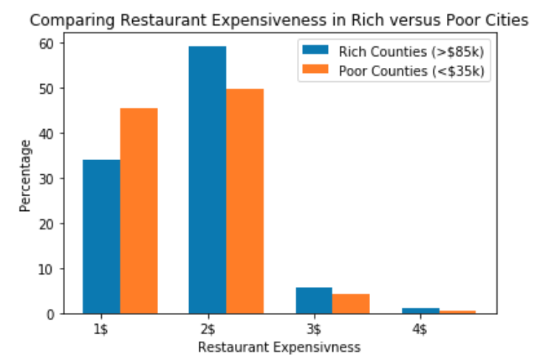
Restaurant Expensiveness in Rich VS Poor Counties
Observations
A meal costs less than <$20 in ~85% of restaurants in both rich and poor counties
In poor counties, the proportion of restaurants where a meal costs less than $10 is 33% higher than in rich counties
In rich counties, the proportion of restaurants where a meal costs $10 - $20 is 20% higher
Notes:
Top chart title: Percentage of Restaurants in a given price category (National)
1$ <10 2$ 11-20 3$ 21-30 4$ 31+

Slide 7
Takeaway
Less competition at higher end restaurants than restaurants with a meal cost less than $20

Slide 8
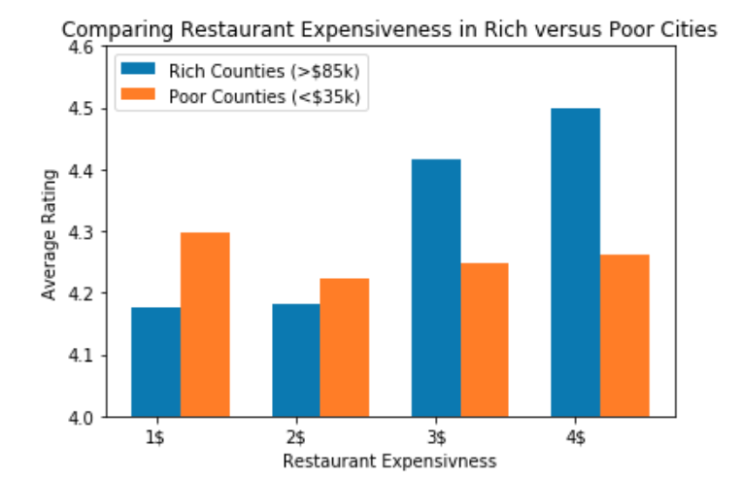
Comparing Average Rating to Restaurant Expensiveness by Rich and Poor Counties
Observations
In rich counties, ratings for higher end restaurants were significantly higher than non expensive restaurants
Whereas in poor counties, the spread was more even., with cheaper restaurants being slightly more popular

Slide 9
Takeaway
Rich counties have a higher appreciation / more tolerance for more expensive restaurants
Poorer counties tend to appreciate more affordable meals.

Slide 10
Popular Restaurant Types in Rich and Poor Counties
Rich Counties
Restaurant Type | Price Category | Percentage (%)
American (New) | $$ | 10%
Pizza | $$ | 10%
Mexican | $ | 8%
Italian | $$ | 8%
Mexican | $$ | 7%
Seafood | $$ | 7%
Indian | $$ | 6%
American (Traditional) | $$ | 6%
Pizza | $ | 6%
Thai | $$ | 6%
American (new) | $$$ | 5%
BBQ | $$ | 5%
Brunch | $$ | 5%
Poor Counties
Restaurant Type | Price Category | Percentage (%)
Mexican | $ | 19%
American (Traditional) | $$ | 9%
American (New) | $$ | 8%
American (Traditional) | $ | 6%
Burgers | $ | 6%
Mexican | $$ | 6%
Pizza | $$ | 6%
Breakfast & Brunch | $ | 6%
Seafood | $$ | 6%
Pizza | $ | 5%
Barbeque | $ | 5%
Delis | $ | 5%
Sandwiches | $ | 4%
Observations
In rich counties, popular restaurants tend to be $$. Whereas in poor counties $ restaurants are more popular

Slide 11
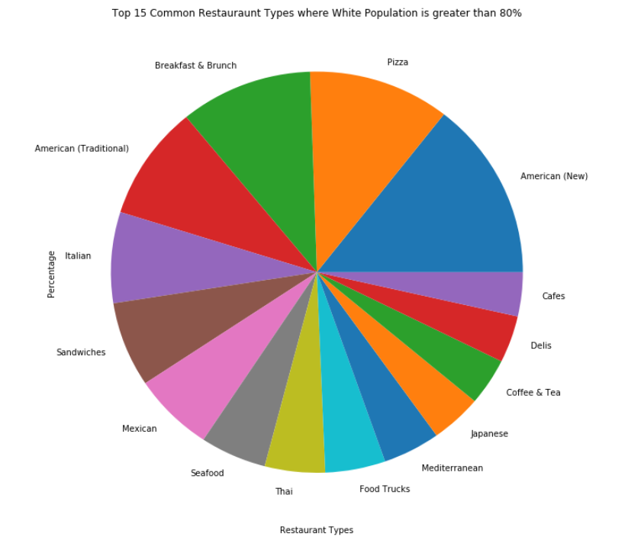
Top 15 Restaurant Types Among White Pop. > 80%
Food types are majority American, European food types.
Almost 50% of most popular food types are American/Italian
You see very few popular ethnic restaurants.

Slide 12
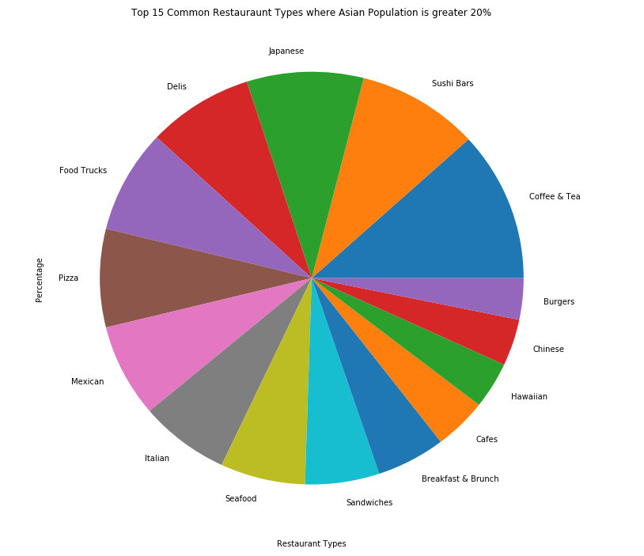
Top 15 Restaurant Types Among Asian Pop. > 20%
You see a variety of ethnic foods.
American food is not among the top food type.
Don’t mess with Asian and their coffee.

Slide 13
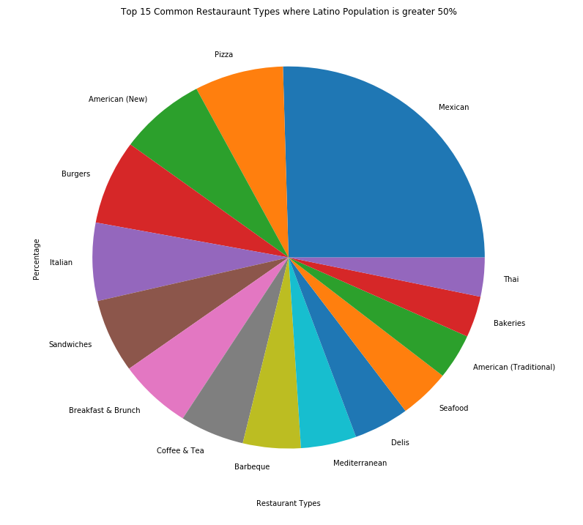
Top 15 Restaurant Types Among Latino Pop. > 50%
Mexican food is dominant among all other food types.
Has many parallel food types with white populations
Bakeries make the top 15 restaurant list.

Slide 14
Take-Away
Counties of a particular ethnic composition have a greater proportion of restaurants associated with that ethnic group.
For example, Italian food is more popular in predominantly white counties than it is in predominantly hispanic counties.

Slide 15
LA City Census Data
Observations based on Census Tracts
Census tracts are relatively stable over time and are meant to represent neighborhoods.
Typically contain around 6000-8000 people
Drawn from Kaggle and from LA County’s data office
This is from Los Angeles “City” not the county
Utilized the Census Geocoder API to match individual restaurant records to census tracts.

Slide 16
Census Data API
Yelp API
Census GeoCoder
Filtering down to just LA
Groupby Census Tract
Merge
Final Dataset

Slide 17
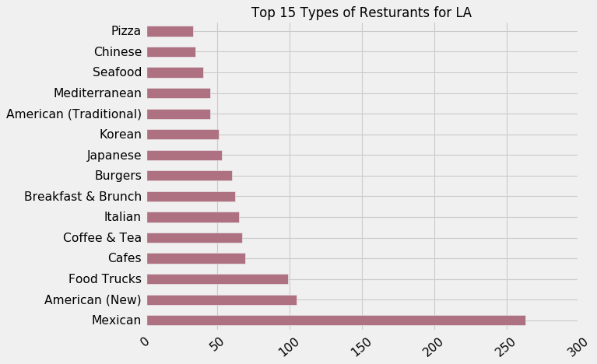
Top 10 Types of Restaurants in Los Angeles
Observations
Mexican food is very popular
LA has a diverse preferences, notable food truck craze
Distinct from broader American restaurant trends.

Slide 18
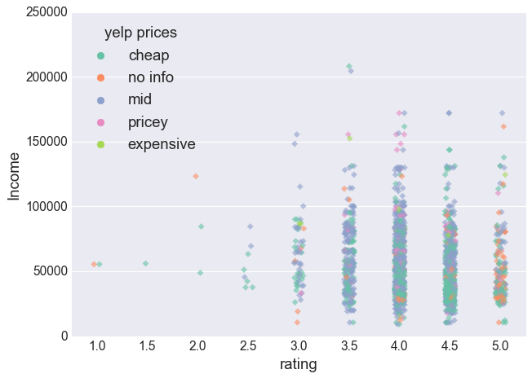
Yelp Ratings vs. Income
Observations
Most Yelp Reviews in LA are above a 3, there seems to be little correlation between price and ratings within census tracts.
Many of the most consistently top rated restaurants either don’t have price info or are cheap, especially in lower income areas

Slide 19
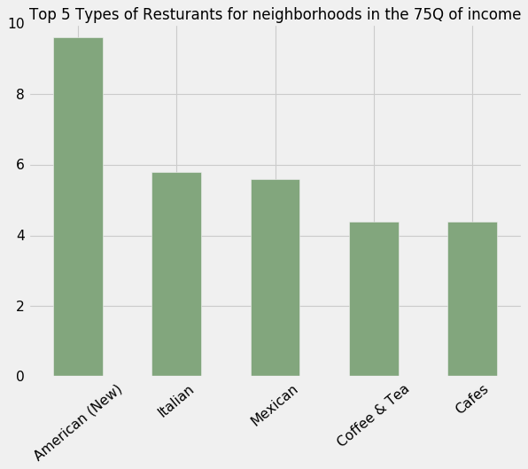
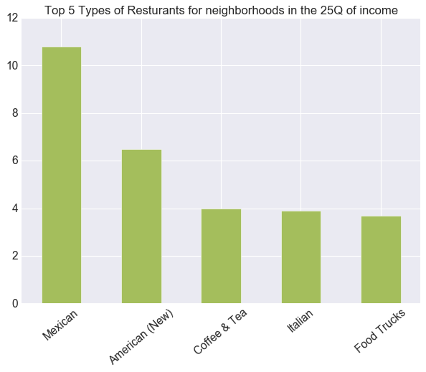
Top 5 Restaurants based on in Income
Similar tastes but food trucks are more common than cafes in lower income areas

Slide 20
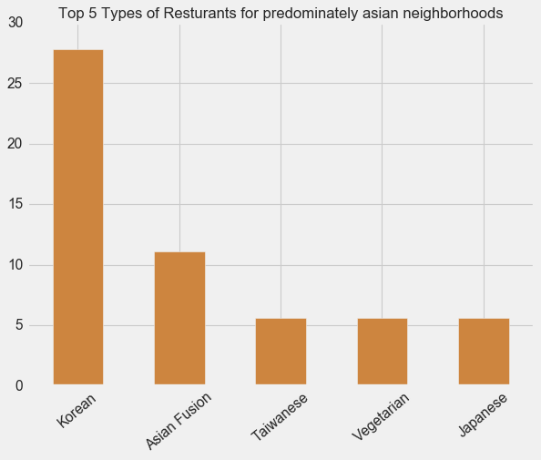
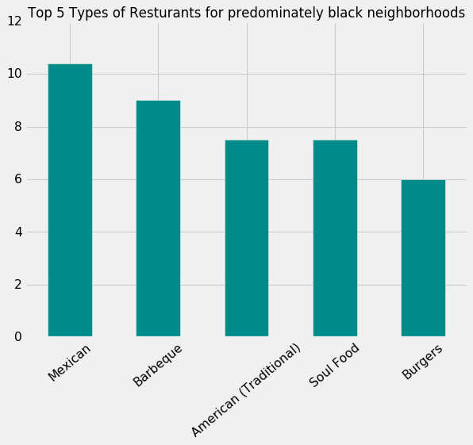
Top 5 Restaurants in Black and Asian Neighborhoods

Slide 21
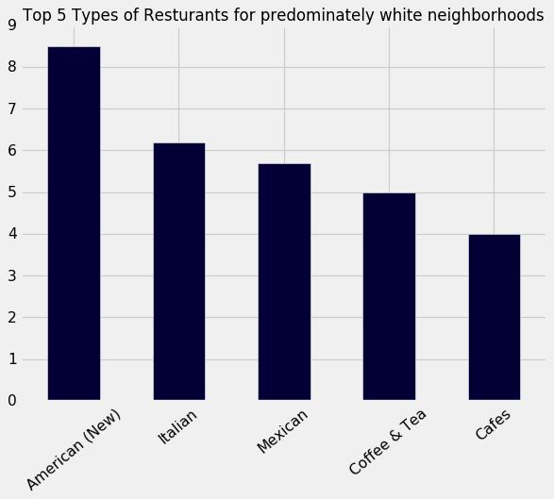
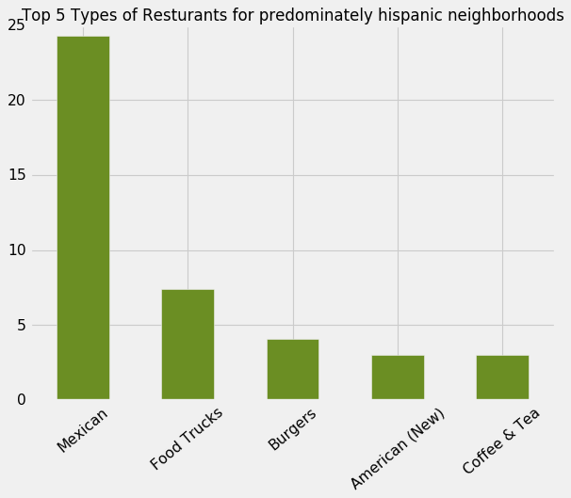
Top 5 Restaurants in Hispanic and White Neighborhoods
Given that the Hispanic population is the single largest ethnic group in LA, and Mexican food is the most common restaurant type in LA. While there are high concentrations of Mexican food establishments in predominantly Hispanic neighborhoods. The top fives are very similar in predominantly White and Hispanic neighborhoods, which make up the majority of LA

Slide 22
Thoughts about the LA Census and Yelp analysis
While certain neighborhoods where an ethnicity predominate exist in LA, it’s not the norm
Census Tracts and Restaurant concentrations are likely more of function of historic districts rather than the tastes of people in LA.
Summary By Tract | White | Black | Asian | Hispanic
mean | 31.71% | 7.41% | 14.39% | 43.43%
std | 26.61% | 12.73% | 14.73% | 29.64%
25Q | 6.1% | 1.1% | 4.2% | 16.7%
Median | 25.85% | 3.2% | 9.9% | 39.1%
75Q | 56% | 6.9% | 19.7% | 68.77%
% of tracts (>60% of pop) | 21% | 1.8% | 2.1% | 31.7%

Slide 23
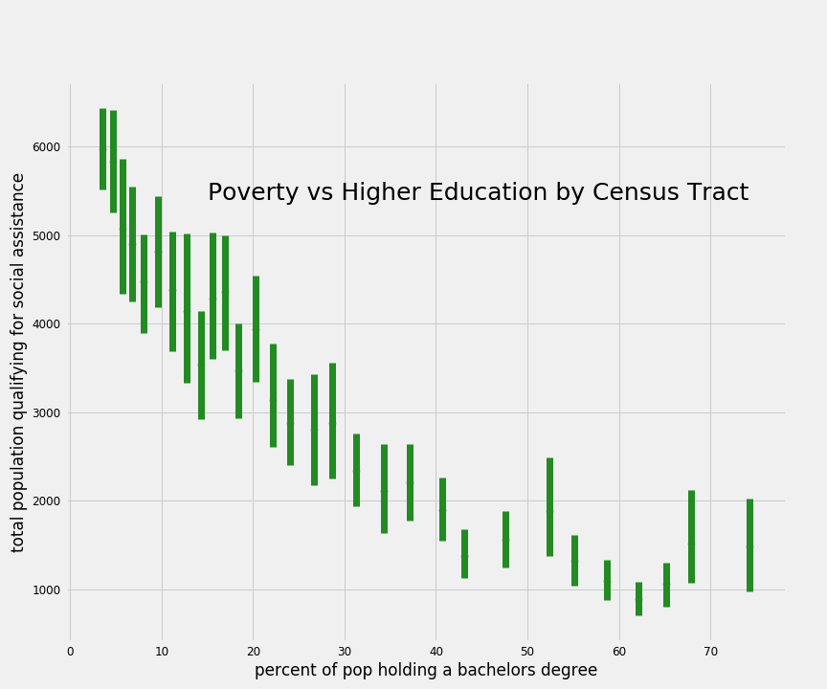
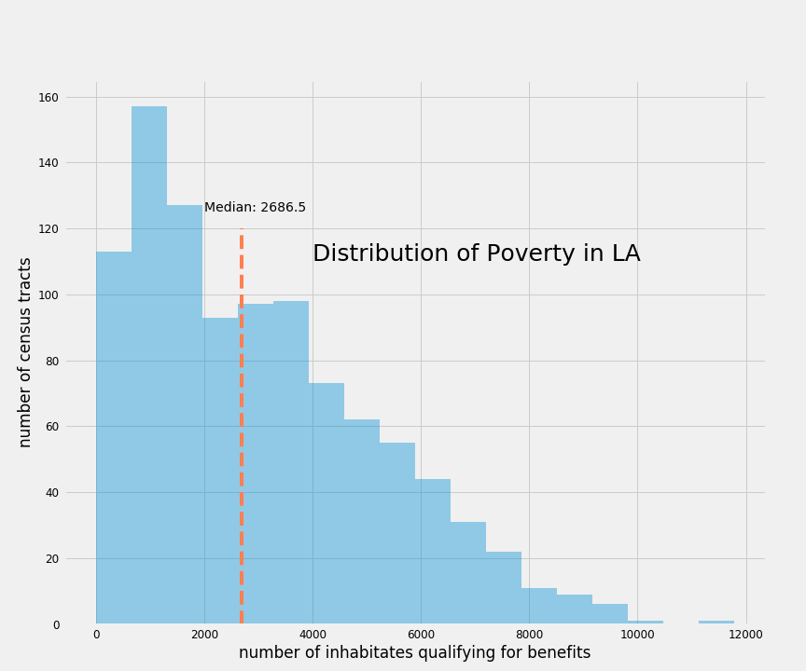
Other findings from the LA Census

Slide 24

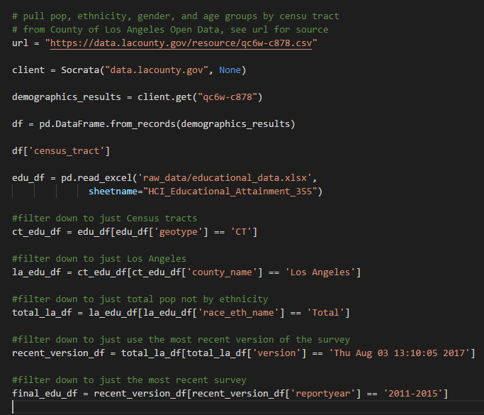
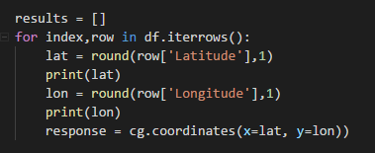
LA Census Code
Lots and Lots of filtering
Managing different census tract code formats was a challenge
Yelp API has an attitude
It’s hard to keep track of large datasets, especially after merging them multiple times

Slide 25
Conflicts, shortcomings, etc.
We do not show standard error.
We have not included review counts
For poor versus rich counties, we do not control for ethnicity.
For counties of different ethnicities, we do not control for income.
We pull the top 50 restaurants based on rankings for the counties. If we pulled based on review count we may get different results.
Incomplete or unclear records from the LA County Data Office: different census tract formats, misleading column names, etc.
Issues trying to connect with Census geocoder API

Slide 26
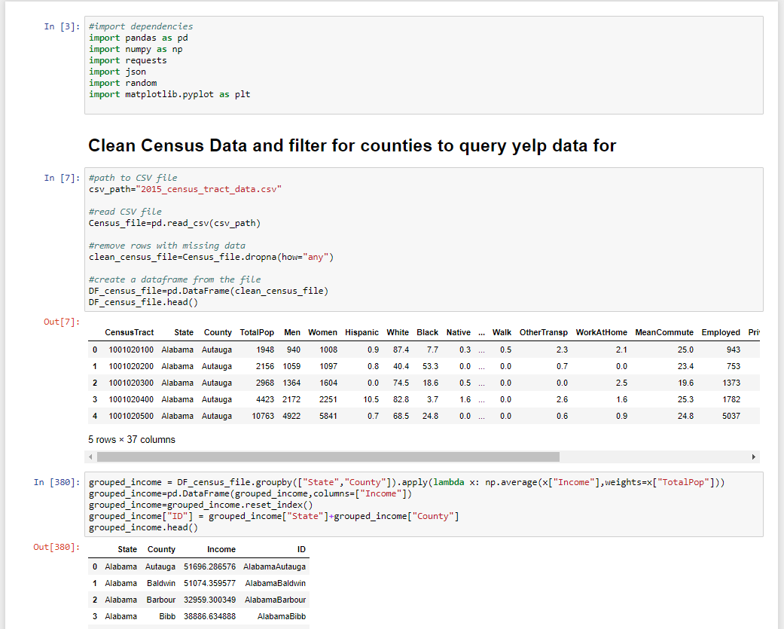

Slide 27
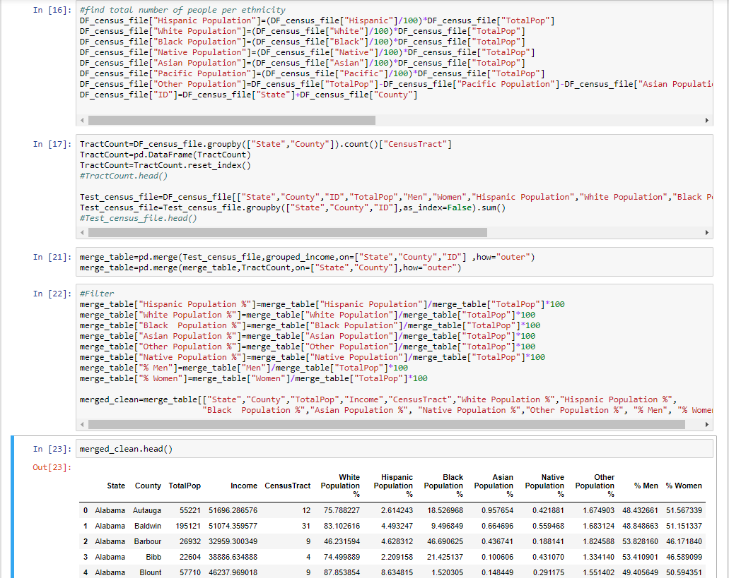

Slide 28
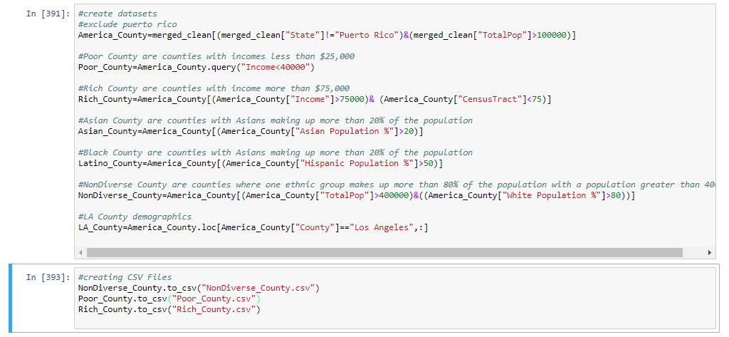

Slide 29
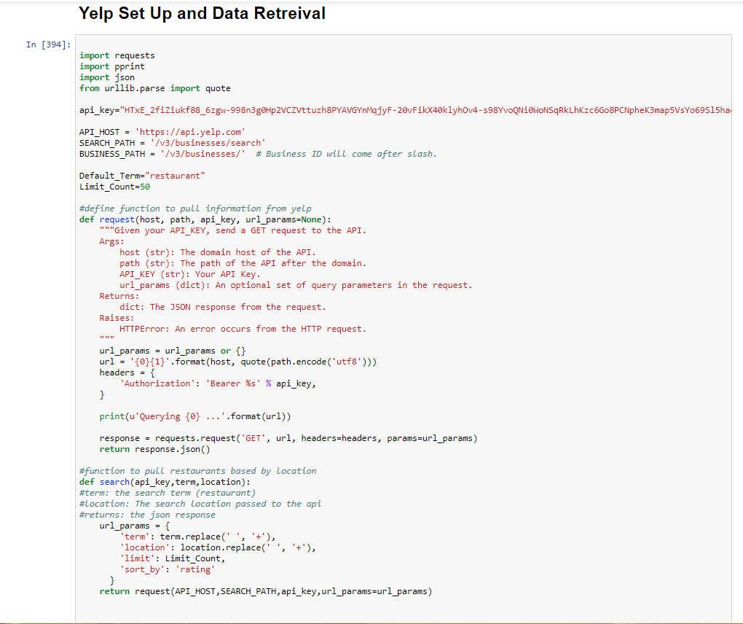

Slide 30


Slide 31
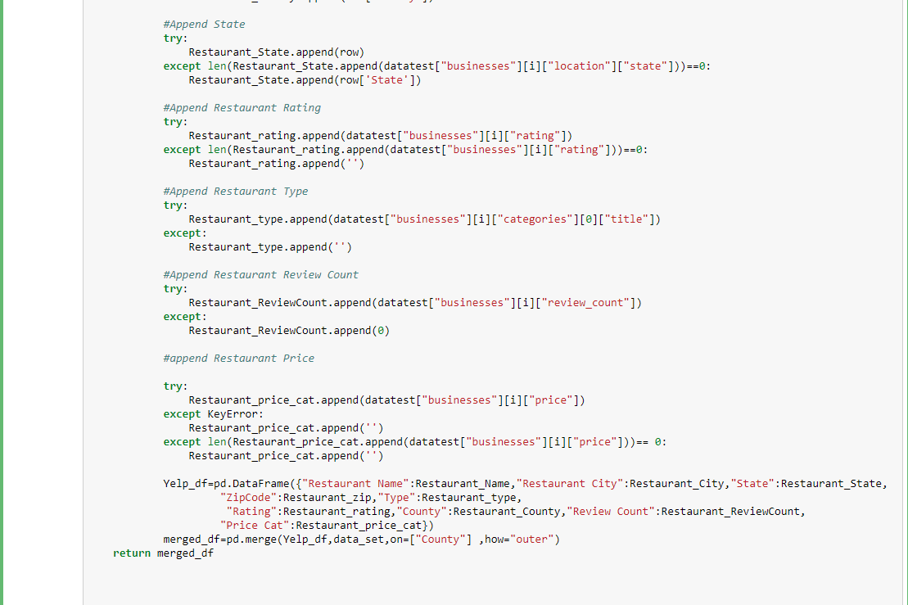

Slide 32
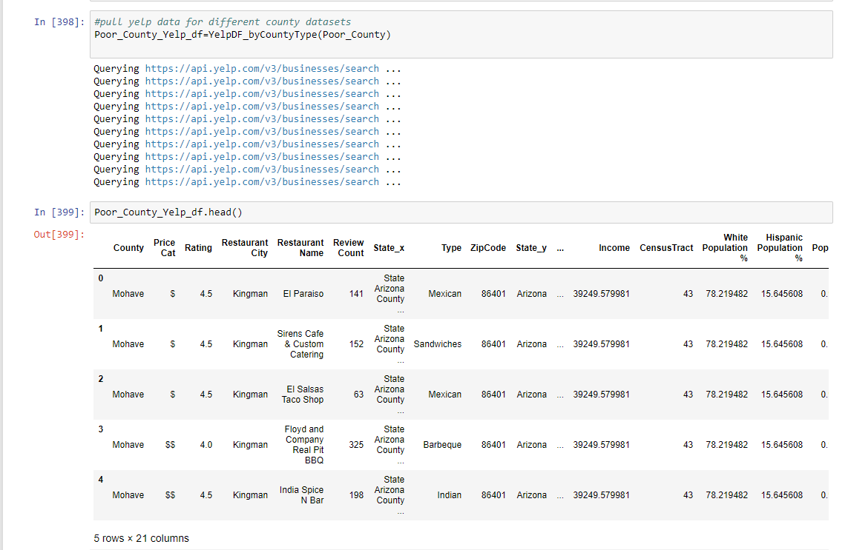

Slide 33
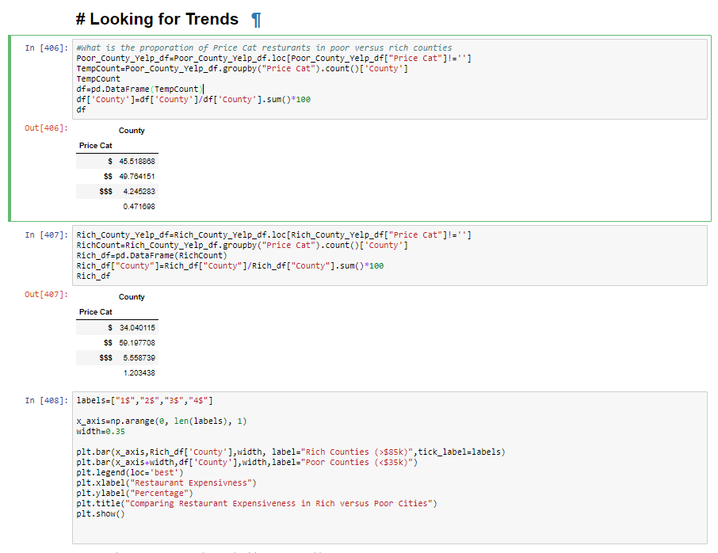

Slide 34
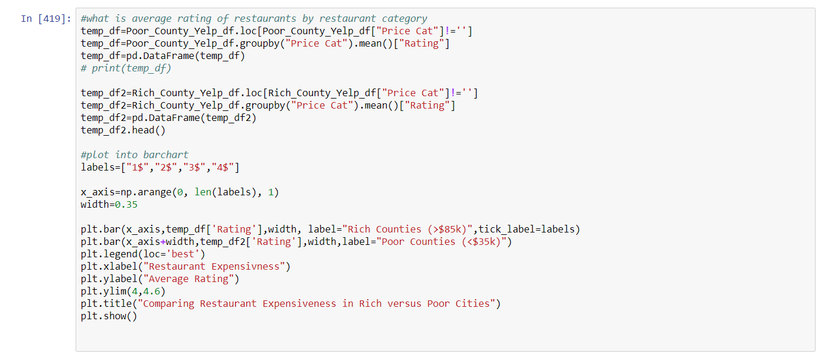

Slide 35
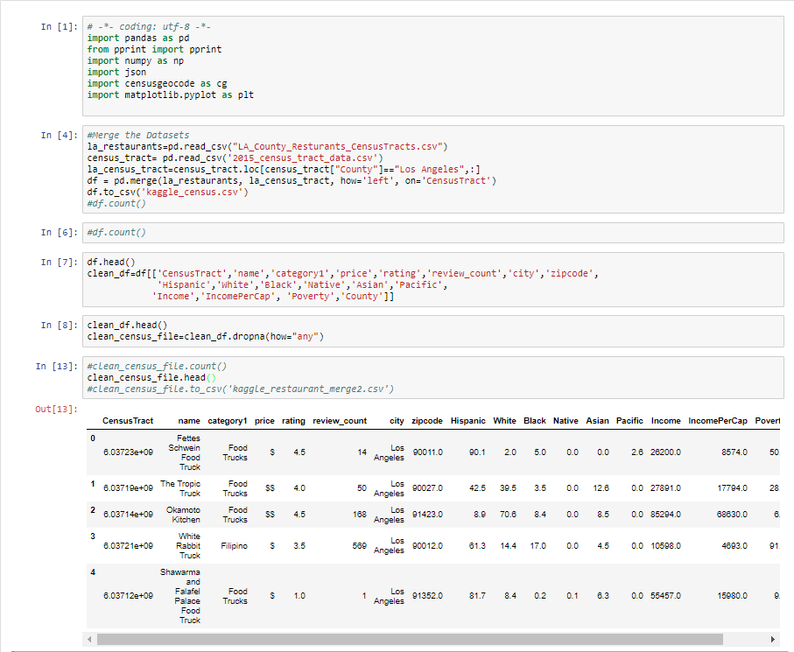

Slide 36
